Slide 1

Data visualization
Airbnb Seattle Analysis
Anuj Mangukiya | 63198824

Slide 2
Dataset overview
Total Rows: ~3,800 listings
Each Row = One Airbnb property listing in Seattle
Purpose: Analyze listings, pricing, availability, and host behavior for travelers, researchers, and business decisions
Rows: Each row represents an individual property listed on Airbnb
Type: Entire home, private room, or shared room
Location Data: Latitude & longitude for mapping and spatial analysis
Host Info: Includes host ID, name, tenure, superhost status
Pricing: Includes price, minimum_nights, maximum_nights, availability_365
Ratings: Multiple review sub-scores (e.g., communication, cleanliness) + overall average rating
Timeline: host_since field indicates when the host joined Airbnb
Amenities & Description: Rich metadata on amenities, detailed text descriptions for each property

Slide 3
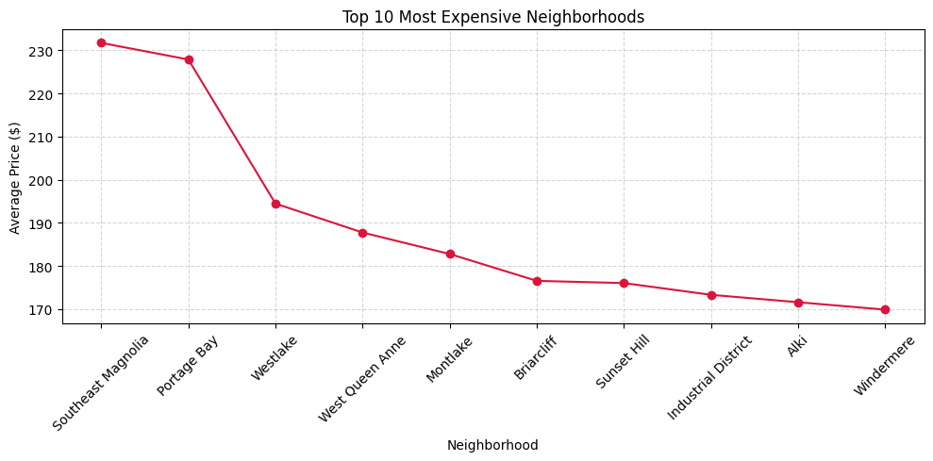
1. What are the most expensive neighborhoods on average?
🏙️ Neighborhoods like Capitol Hill, Queen Anne, and Downtown have the highest average prices.
🧾 Less popular areas like Beacon Hill and Rainier Valley are more affordable.
🔍 Prices are highly localized and vary sharply within Seattle.

Slide 4
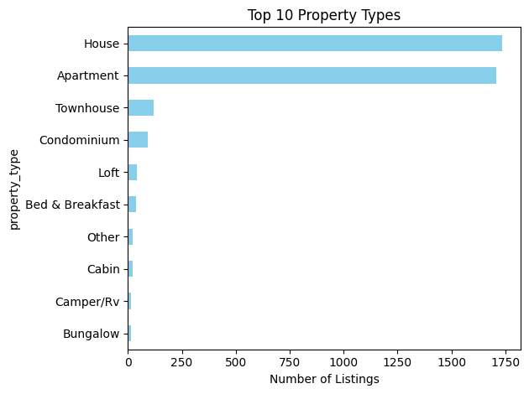
2. What types of properties are most common?
🏡 Entire home/apartment is the most dominant property type, showing that most hosts offer full spaces for rent rather than shared ones.
🛏️ Private rooms are the second most common, providing more affordable options while still offering privacy.
🧱 Other types like Condominiums, Townhouses, and Lofts are also popular, reflecting Seattle's urban housing diversity.
🌿 Unconventional listings such as Treehouses and Tiny houses highlight Airbnb's unique experiences and niche appeal in the city.

Slide 5
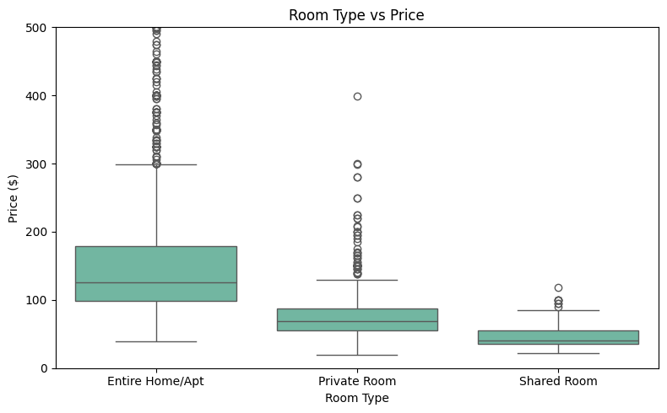
3. How does room type affect price?
💰 Entire home/apartment listings have the highest average prices and the widest price range.
🚪 Private rooms are significantly more affordable and more consistent in pricing, with fewer extreme outliers.
👥 Shared rooms are the cheapest, but very few listings fall into this category, indicating low supply and demand.
🎯 The chart clearly shows that room type is a major driver of pricing, with full-space rentals demanding a premium.

Slide 6
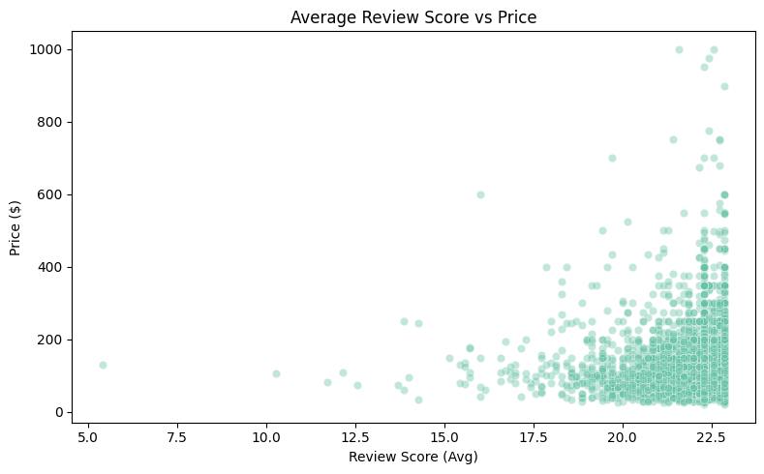
4. Is there a relationship between review scores and price?
⭐ No clear relationship between higher price and better reviews.
✅ Many moderately priced listings (~$100–$200) have top reviews.
⚠️ High-end listings don’t guarantee better ratings — experience matters more than cost.

Slide 7
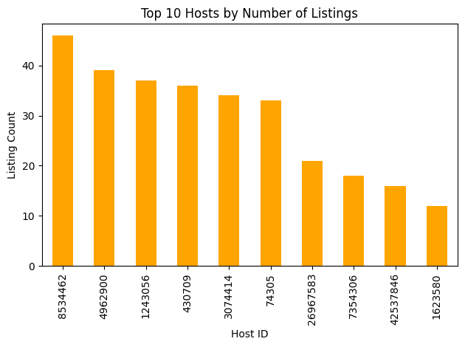
5. Which hosts have the most listings?
👤 A few hosts manage a large number of listings — possibly commercial operators.
🏡 Majority of hosts have only 1 or 2 properties.
📊 Suggests Airbnb is a mix of individuals and businesses.

Slide 8
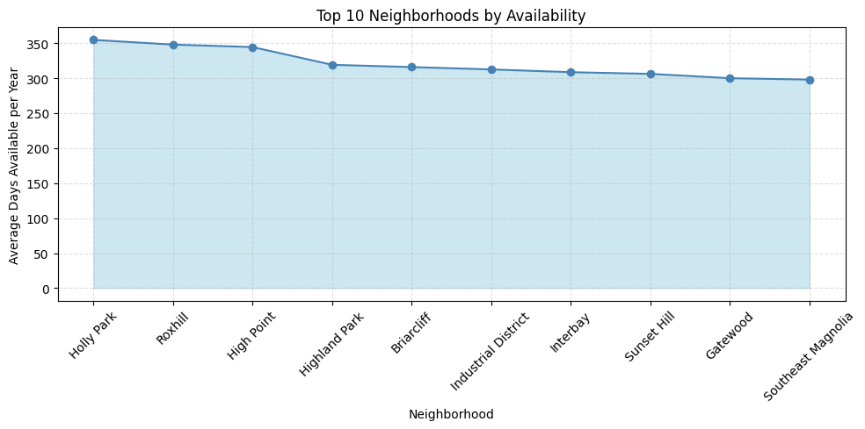
6. What is the availability of listings across neighborhoods?
📆 Downtown, Capitol Hill, and Queen Anne have the highest average availability.
🗓️ Suburbs or residential zones tend to have listings available only part-time (seasonal hosting).

Slide 9
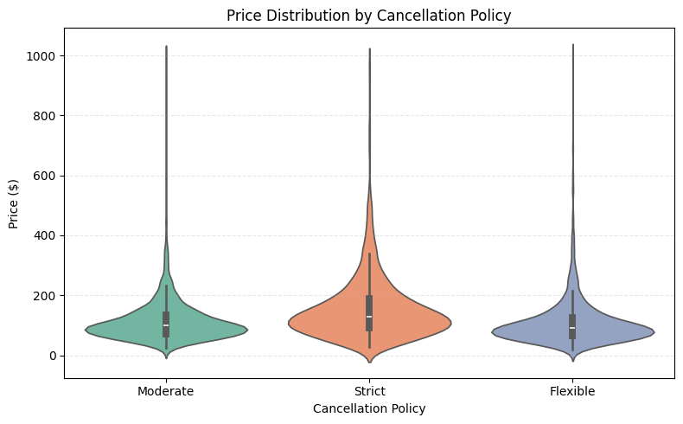
7. How does cancellation policy affect pricing?
💰 Listings with strict policies show a wider and higher price distribution.
✅ Moderate and flexible policies are more commonly associated with mid-range prices.
⚖️ Suggests guests are willing to pay extra for riskier but premium experiences.

Slide 10
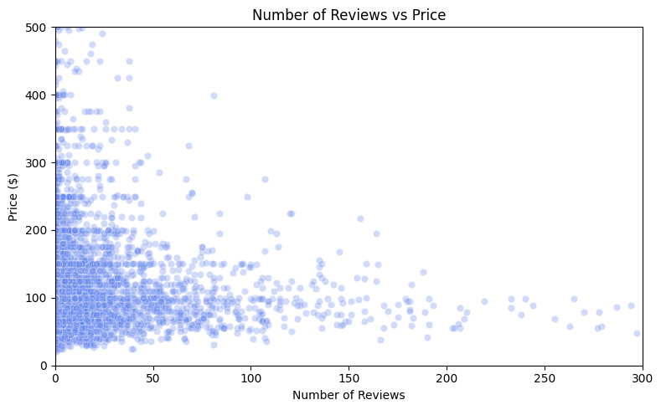
8. How does the number of reviews relate to price?
💬 Listings with lower to mid-level prices get more reviews.
💸 Very expensive listings receive fewer reviews, possibly due to lower booking volume.
📉 Review volume decreases significantly above the $300–$400 range.

Slide 11
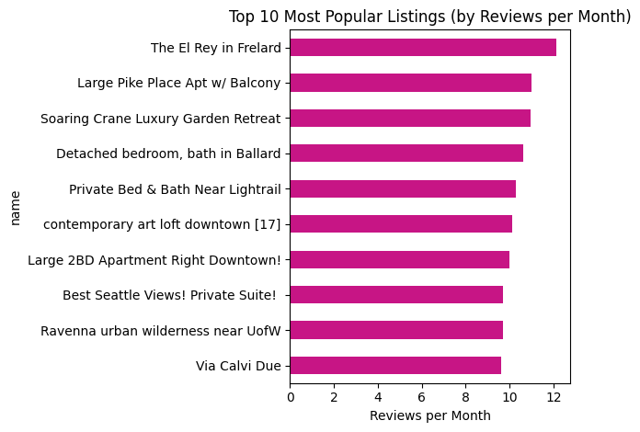
9. Which listings are most popular based on reviews per month?
🔝 A few listings dominate with 5+ reviews per month — these are highly active.
🌟 Popular listings often have competitive pricing and high ratings.
🧲 Suggests a sweet spot in pricing leads to better customer engagement.

Slide 12
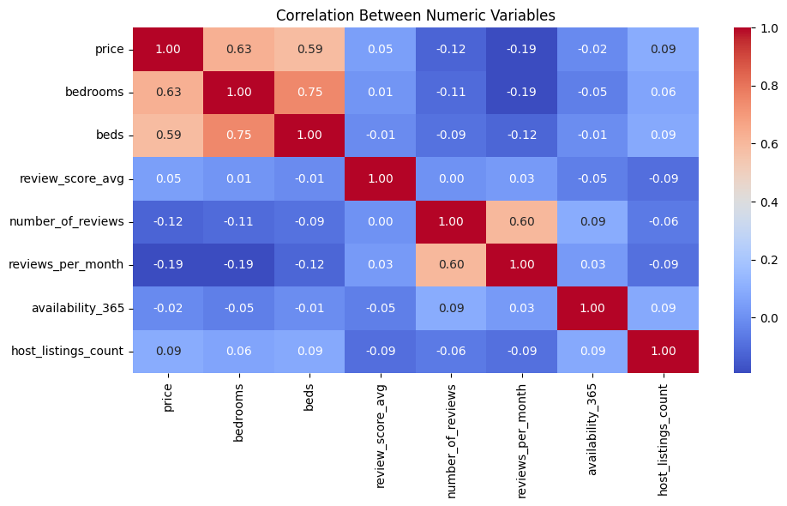
10. What’s the correlation between key numeric variables?
🏙️ Neighborhoods like Capitol Hill, Queen Anne, and Downtown have the highest average prices.
🧾 Less popular areas like Beacon Hill and Rainier Valley are more affordable.
🔍 Prices are highly localized and vary sharply within Seattle.

Slide 13
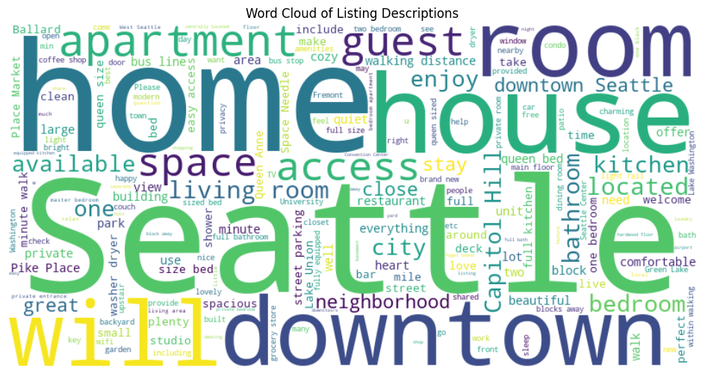
Extra Visualization: Word Cloud of Listing Descriptions
🏙️ Neighborhoods like Capitol Hill, Queen Anne, and Downtown have the highest average prices.
🧾 Less popular areas like Beacon Hill and Rainier Valley are more affordable.
🔍 Prices are highly localized and vary sharply within Seattle.

Slide 14
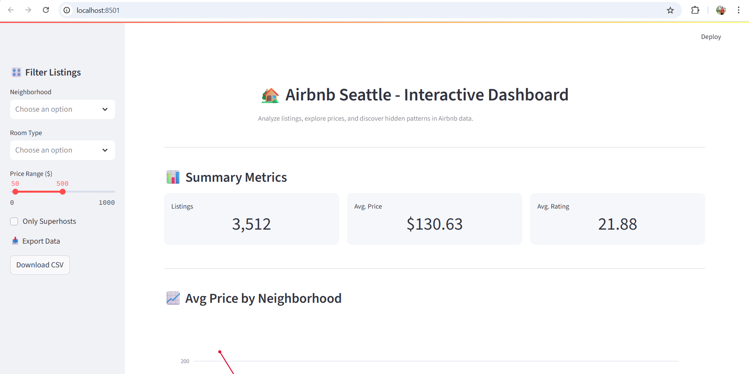
Stram lit dashboard

Slide 15
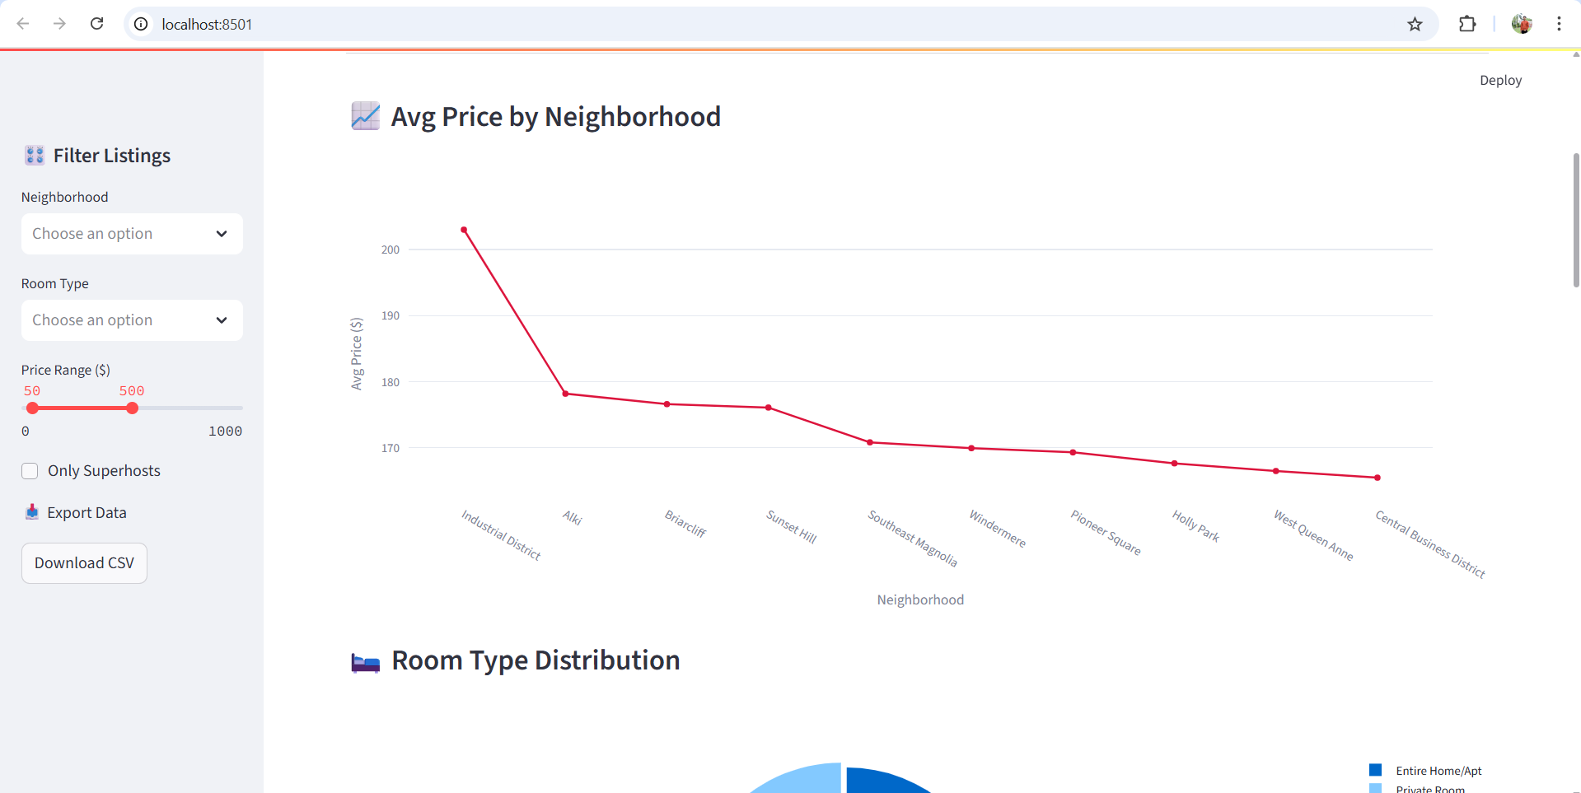

Slide 16
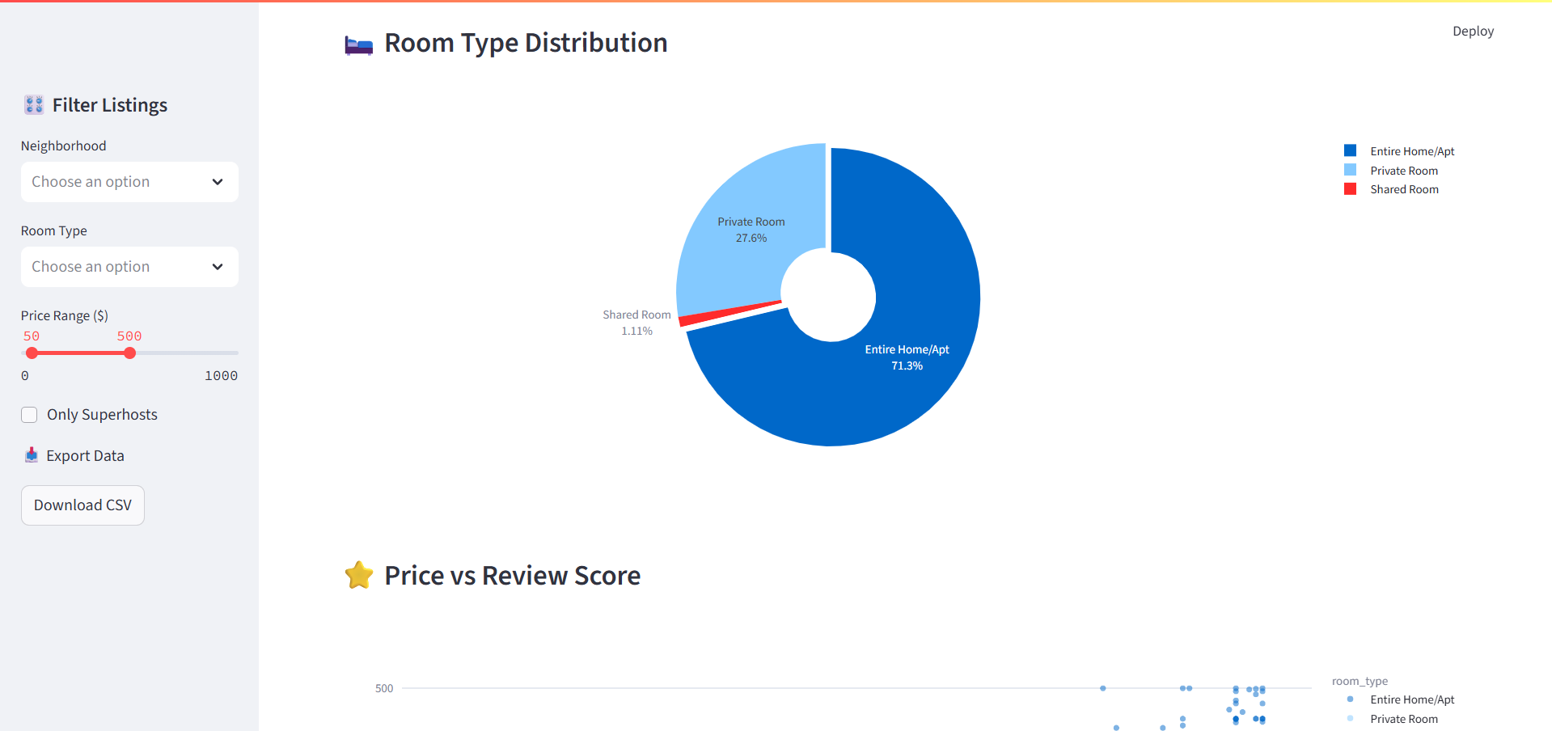

Slide 17
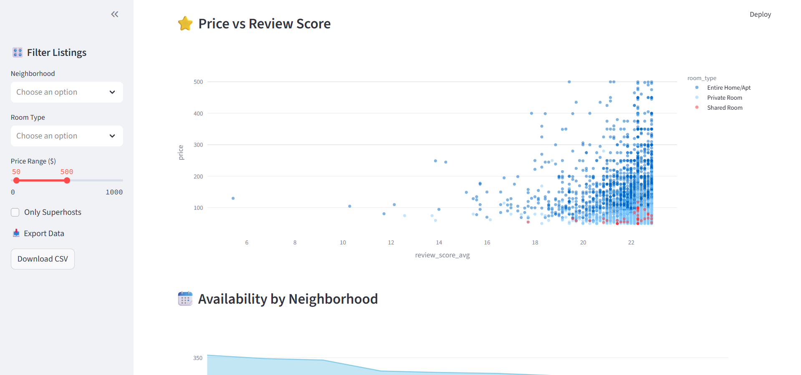

Slide 18
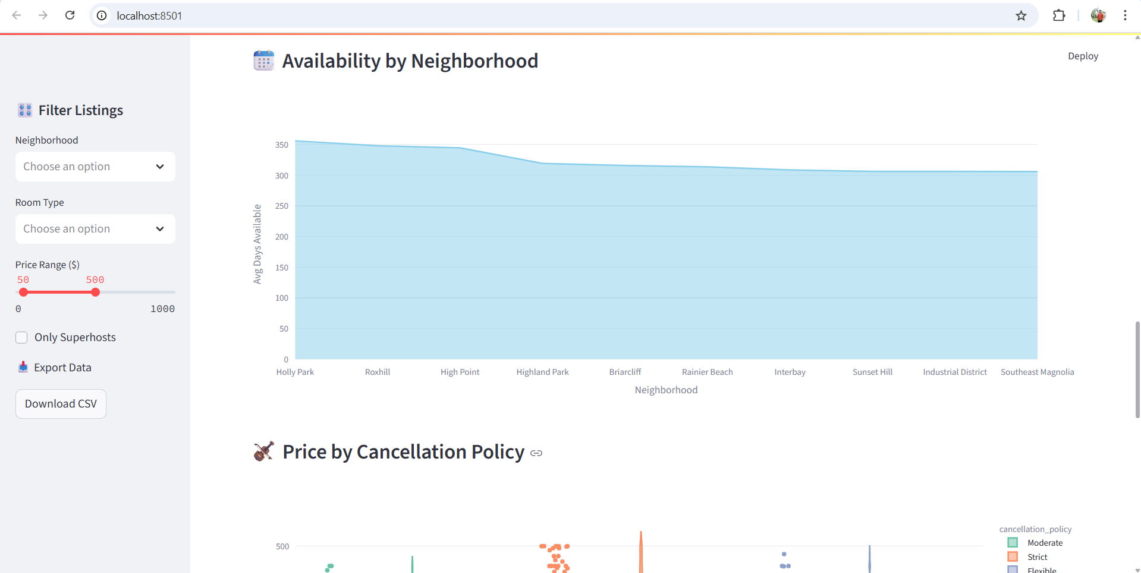

Slide 19
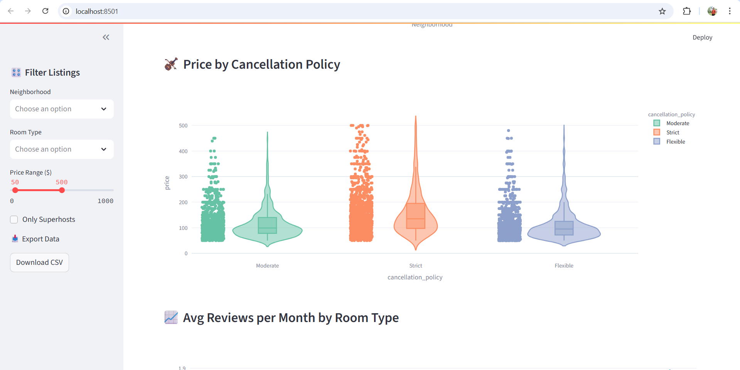

Slide 20
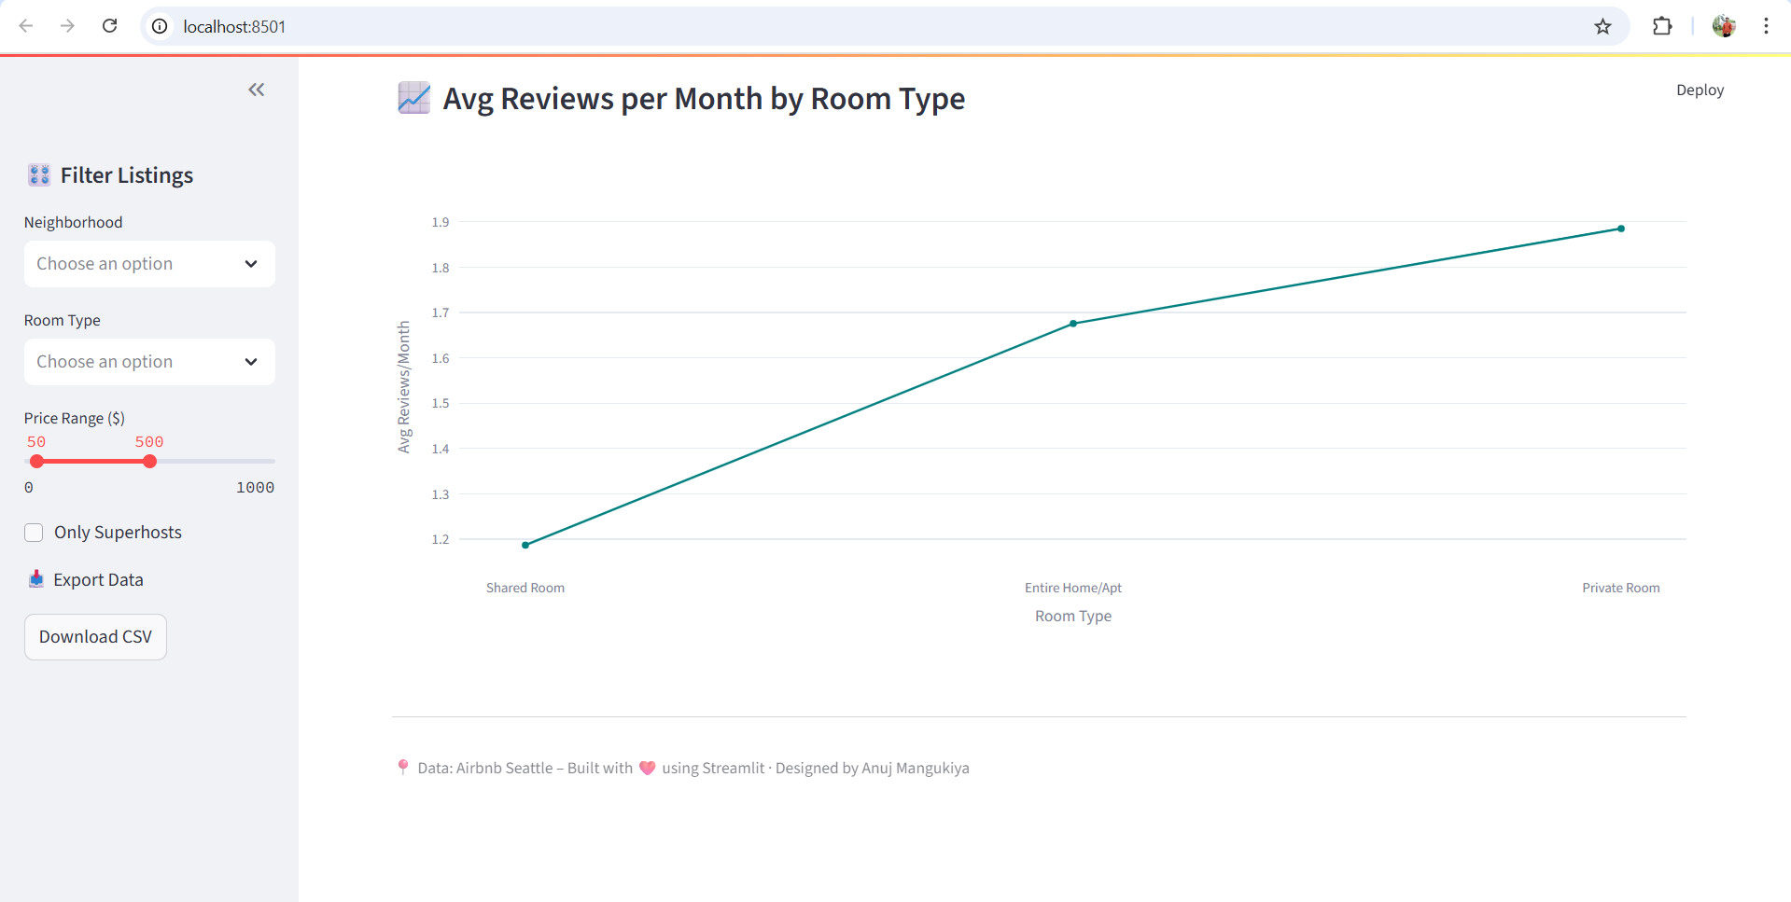

Slide 21
Thank you
Airbnb Seattle Analysis
Anuj Mangukiya | 63198824

